Slide 1
Chapter-4
Interfacing I/O Devices
4.1 BASIC INTERFACING CONCEPTS
An I/O device can be interfaced with the 8085 microprocessor either any of the following:
Peripheral I/O or I/O mapped I/O or Port addressed I/O
Memory mapped I/O
In peripheral I/O an 8-bit port is used to interface I/O with the processor. Intel 8085 processor uses peripheral I/O for data transfer. But, in memory mapped I/O a 16-bit memory register is used to interface I/O with the processor. Motorola 68000 processor uses memory mapped I/O for data transfer.
Peripheral I/O Instructions
In peripheral I/O the 8085 microprocessor uses two instructions for data transfer between the processor and the I/O devices. The instructions are IN and OUT.

Slide 2
OUT Instruction:
An OUT instruction is used to give any output to an output device such as monitor, LED etc. The syntax of an OUT instruction is as follows:
OUT 8-bit Port Address
Mnemonic Machine Code Memory Address Memory Contents
OUT 01H D3 2050 11010011
01 2051 00000001
4.1.2 I/O Execution
OUT INSTRUCTION

Slide 3
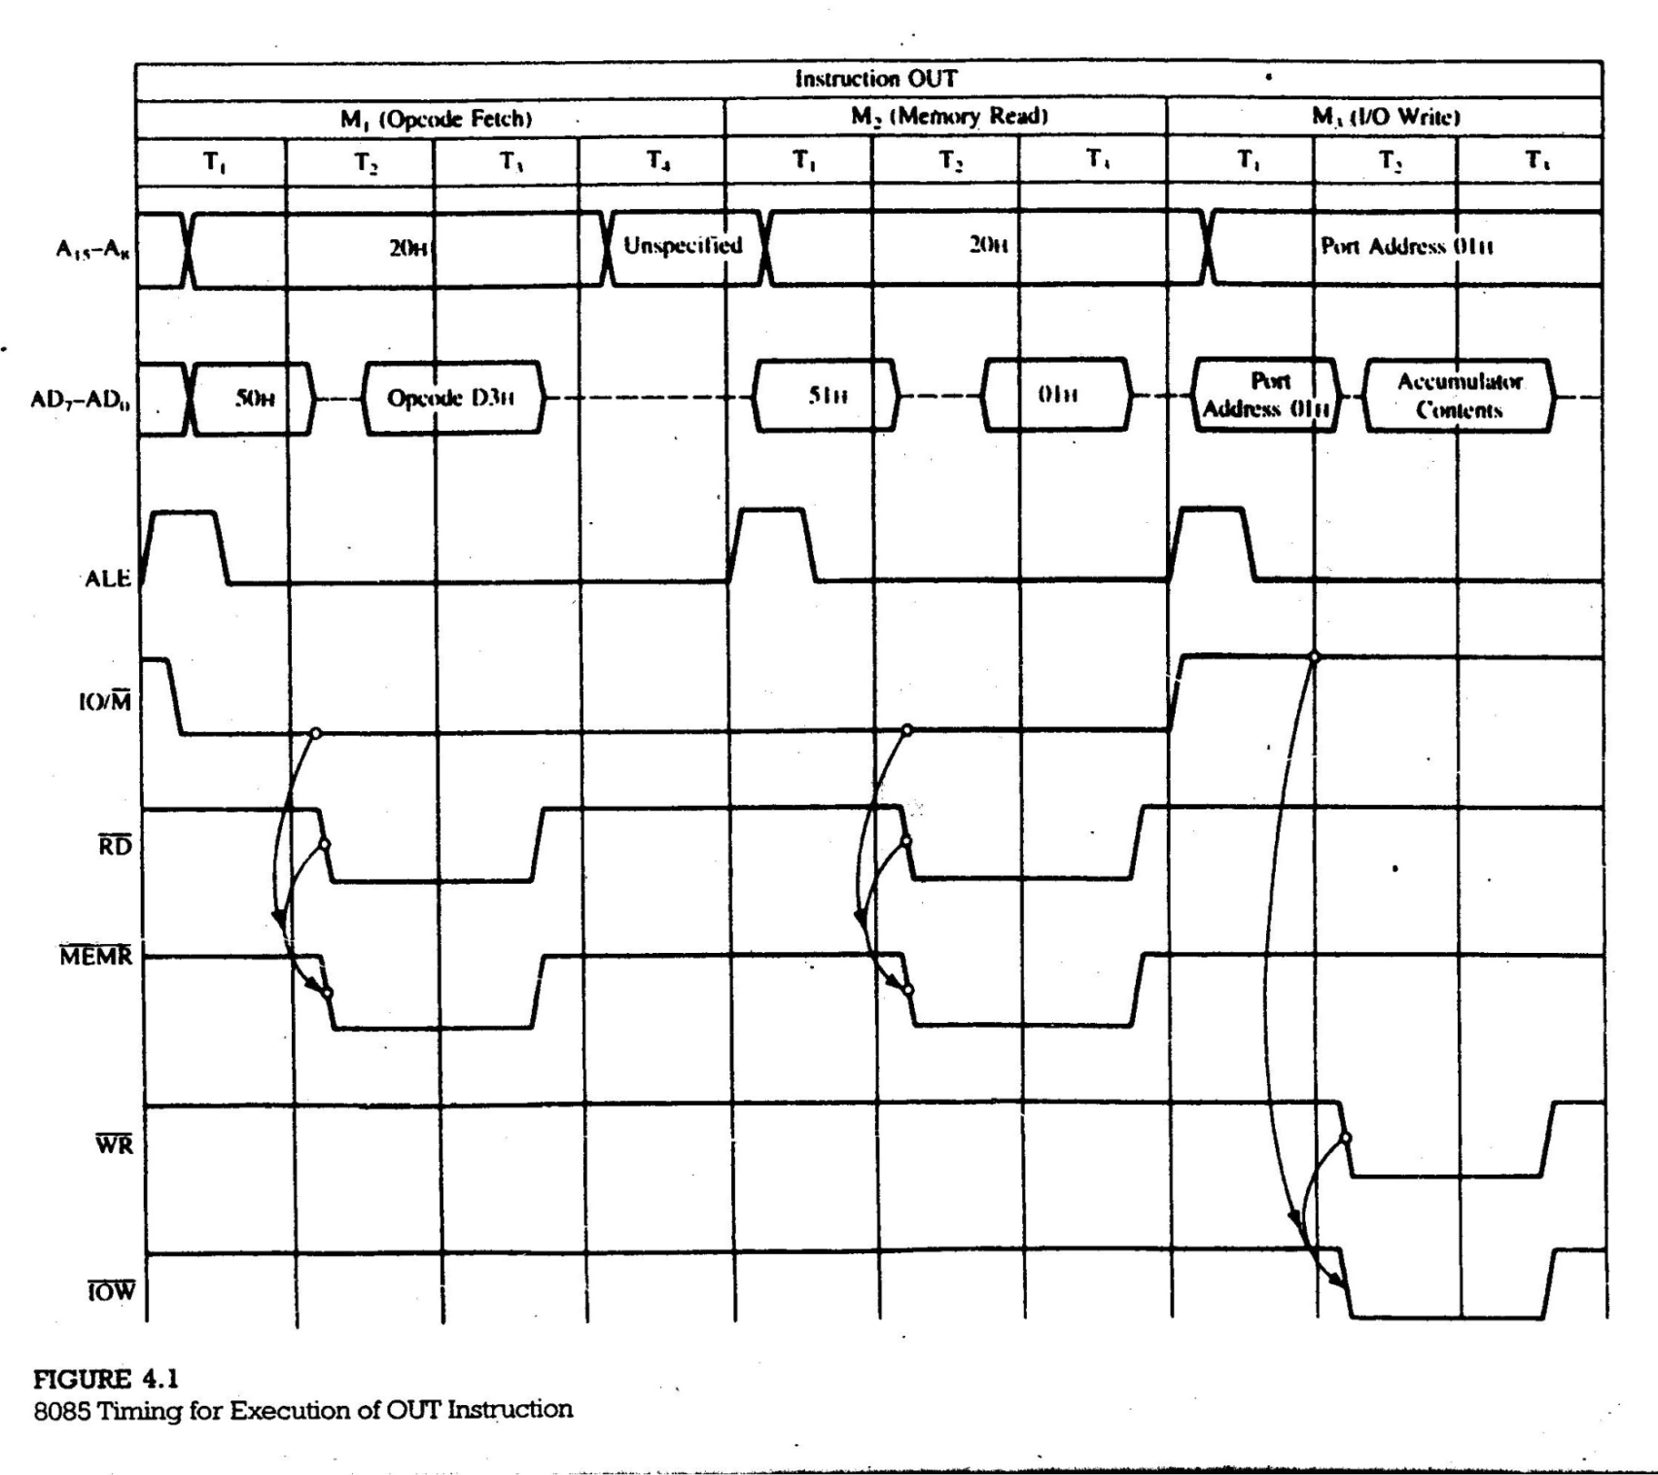

Slide 4
IN Instruction: An IN instruction is used to take any input from an input device such as keyboard, switch etc. The syntax of an IN instruction is as follows:
IN 8-bit Port Address
Mnemonic Machine Code Memory Address Memory Contents
IN 84H DB 2065 11011011
84 2066 10000100

Slide 5
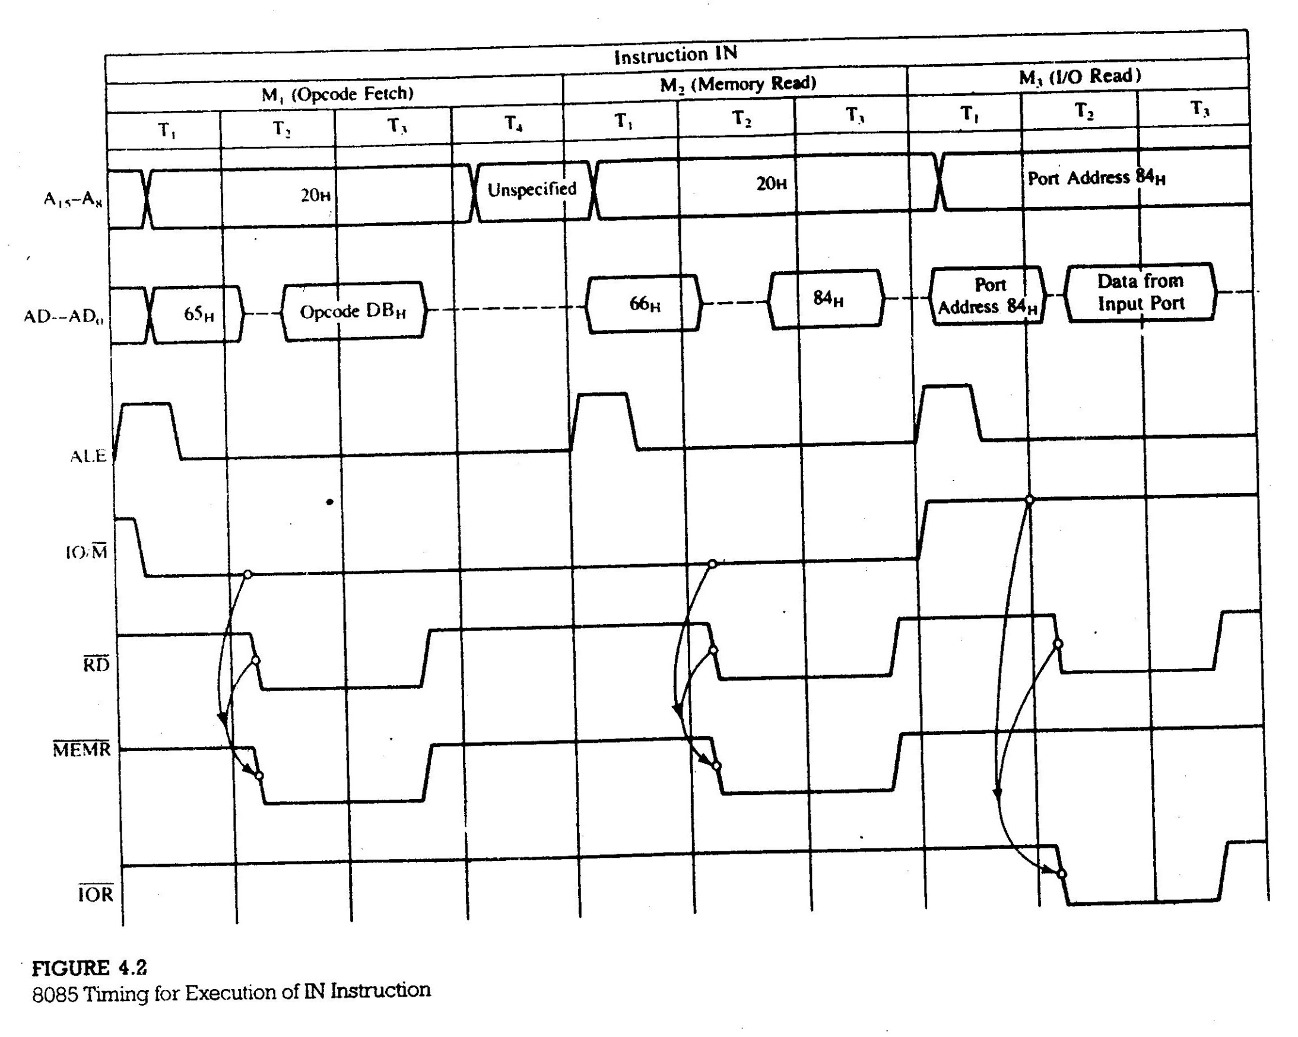

Slide 6
5.1.3 Device Selection and Data Transfer
Two problems regarding the I/O data transfer (M₃ cycle of OUT and IN instruction timing wave form):
When should we enable the latch (or buffer for IN) to catch the information?
What should be the address of that latch?
The solution of above problems are as follows:
Decode the address bus to generate a unique pulse called the device address pulse or I/O address pulse.
Combine (AND) the device address pulse with the control signal to generate a device select pulse (I/O select pulse).
Use the I/O select pulse to activate the interfacing device (I/O port).
Figure 4.3 shows a block diagram and Figure 4.4 shows an example of above solution.

Slide 7
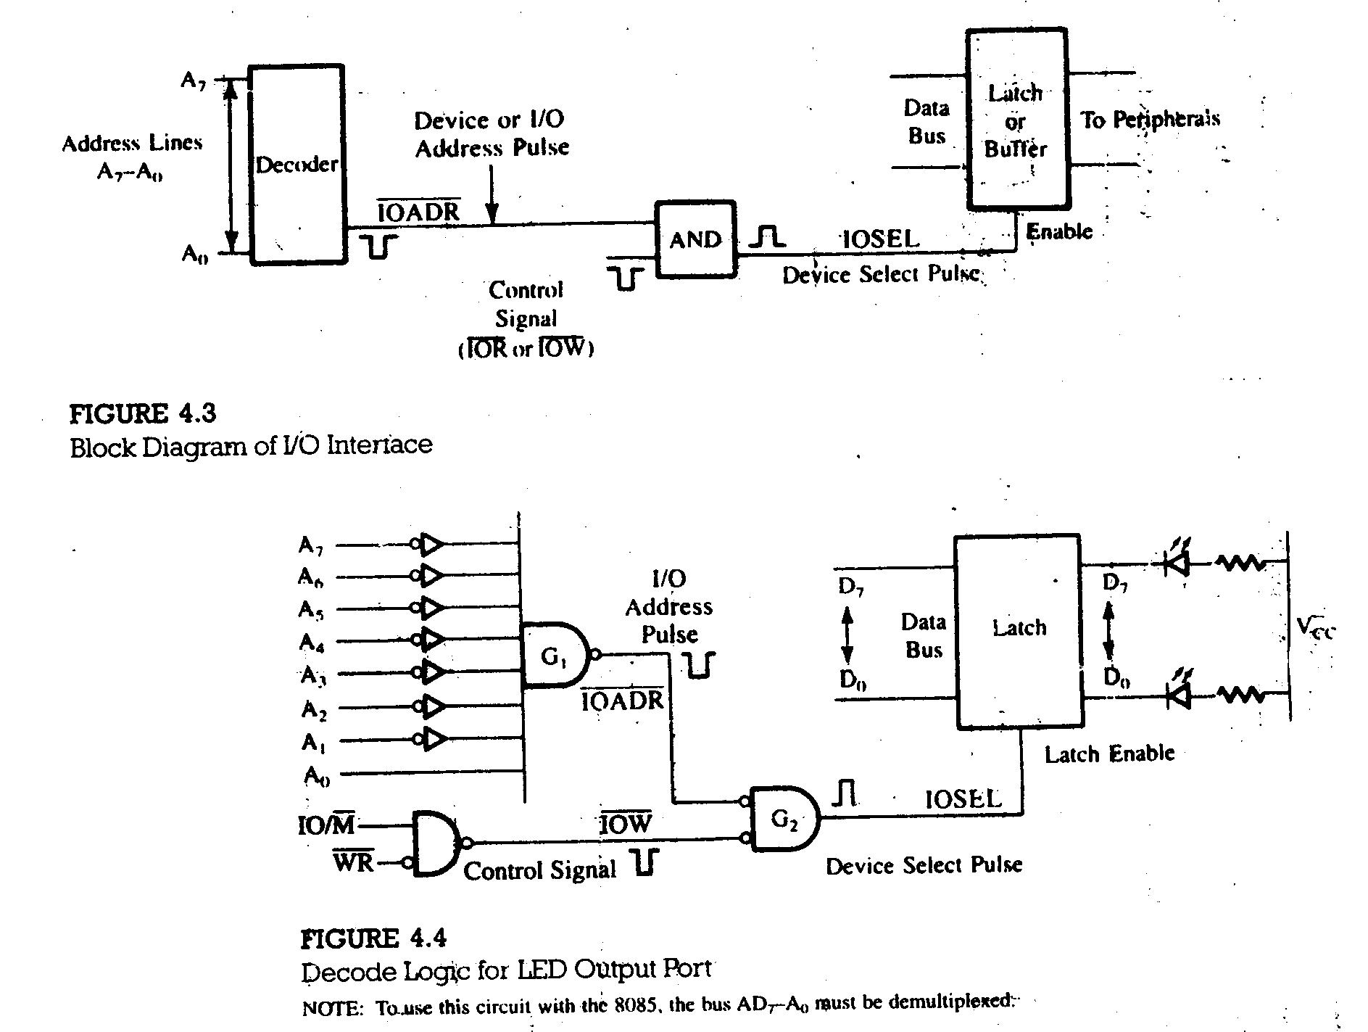

Slide 8
4.14 Absolute Vs. Partial Decoding
In Figure 4.4, all eight lines are decoded to generate one unique output pulse; the device will be selected only with the address, 01H. This is called absolute decoding and good design practice.
However, to minimize the cost, the output port can be selected by decoding some of the address lines ,as shown in Figure 4.5; this is called partial decoding. As a result, the device has multiple addresses.
Figure 4.5 is similar to Figure 4.4 except that the address lines A0 and A1 are not connected, and they are replaced by IO/M and WR signals. Because the address lines A0 and A1 are at don’t care logic level, they can be assumed 0 or 1. Thus this output port (latch) can be accessed by the addresses 00H, 01H, 02H, and 03H.
The partial decoding is commonly used technique in small systems. Such multiple addresses will not cause any problem, provided these addresses are not assigned to any other output ports.

Slide 9
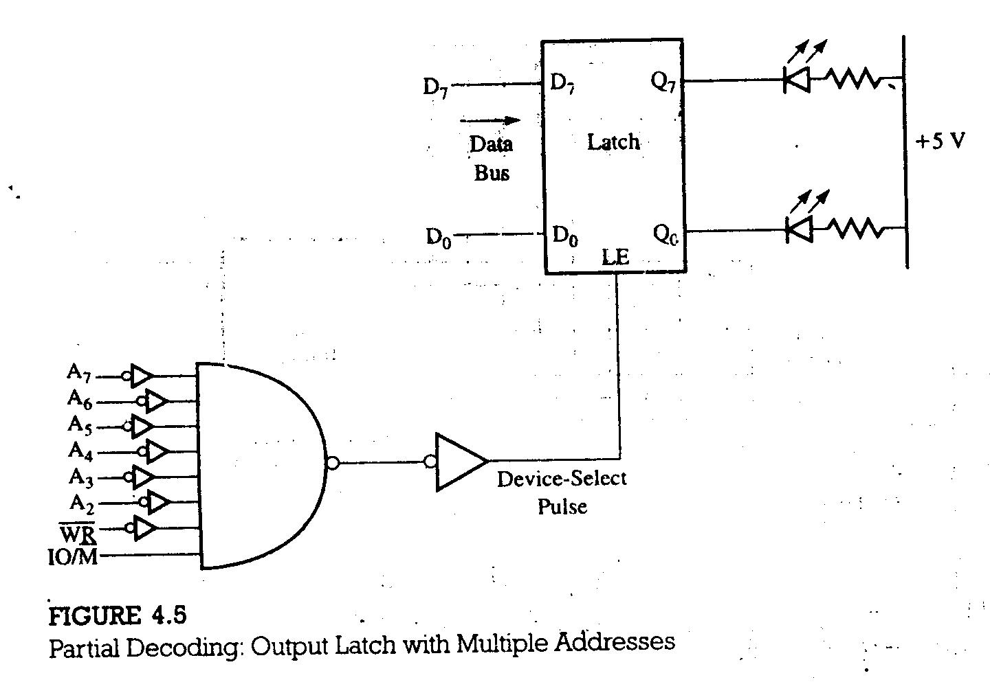

Slide 10
4.15 Input Interfacing
Figure 4.6, shows an example of interfacing an 8-key input port. The circuit for the input port in Figure 4.6 differs from the output port in Figure 4.4 as follows:
Control signal IOR is used in place of IOW.
The tri-state buffer is used as an interfacing port in place of the latch.
In Figure 4.6, data flow from the keys to the accumulator; on the other hand, in Figure 4.4, data flow from the accumulator to the LEDs.

Slide 11
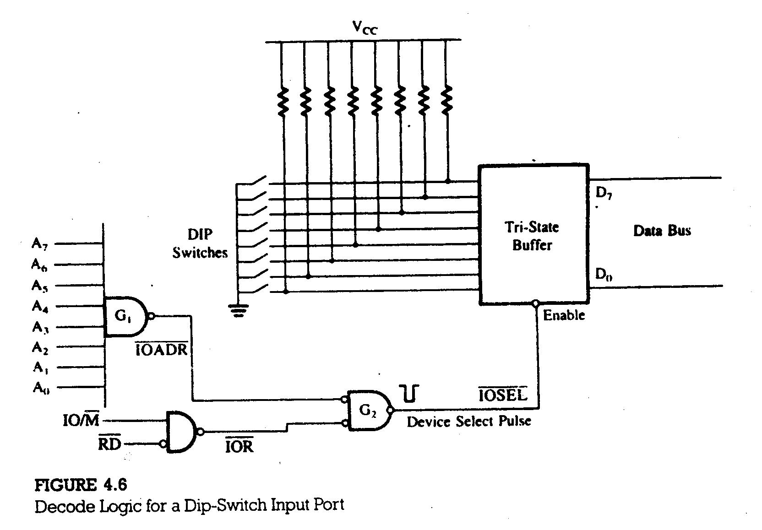

Slide 12
4.16 Interfacing I/Os Using Decoders
Figure 4.7 illustrates how a decoder is used to decode the address of input port and output port. To select or enable the tri-state buffer and latch respectively, following addresses are used to decoded by the decoder (Figure 4.7)
A₇ A₆ A₅ A₄ A₃ A₂ A₁ A₀
1 1 1 1 1 0 0 0
= F8H (Latch)
1 1 1 1 1 0 1 0
= FAH (Buffer)

Slide 13
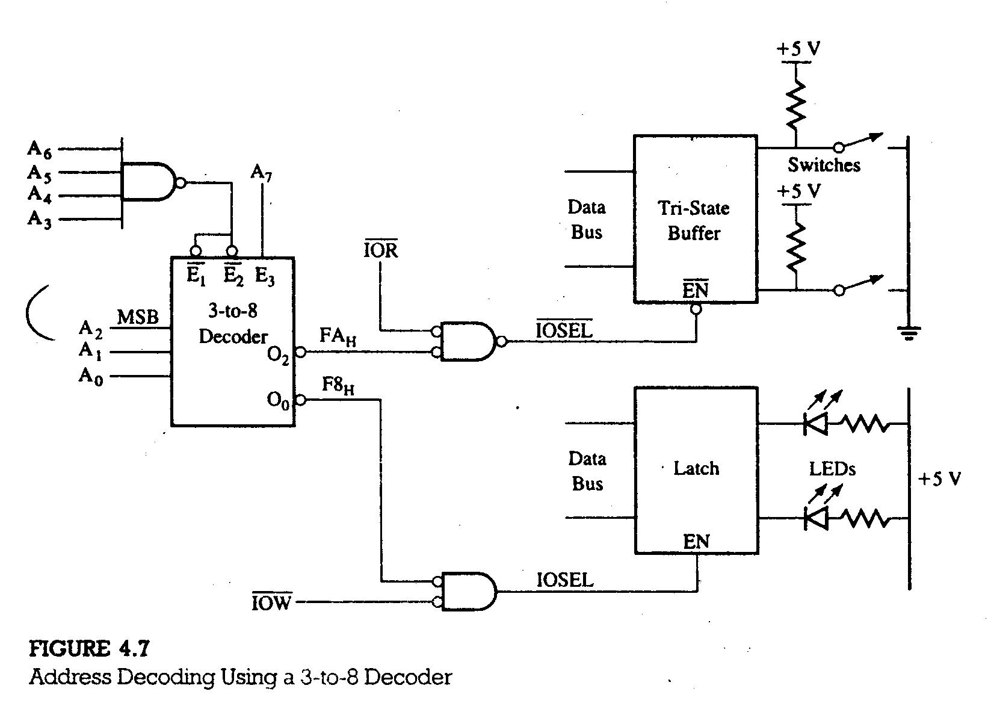

Slide 14
4.2 INTERFACING OUTPUT DISPLAYS
4.22 Illustration: Seven-Segment LED Display as an Output Device
PROBLEM STATEMENT
Design a seven-segment LED output port with the device address F5H, using a 74LS138 3-to-8 decoder, a 74LS20 4-input NAND gate, a 74LS02 NOR gate, and a common-anode seven-segment LED.
Given WR and IO/M signals from the 8085, generate the IOW control signal.
Explain the binary codes required to display 0 to F Hex digits at the seven-segment LED.
Write instructions to display digit 7 at the port.

Slide 15
HADWARE DESCRIPTION
The circuit description is given below:
SEVEN-SEGMENT DISPLAY
A seven-segment LED consists of seven light emitting diode and one segment for the decimal point. The LEDs are physically arranged as shown in Figure 4.9 (a). To display a number, the necessary segments are lit by sending an appropriate signals for current flow through diodes.

Slide 16
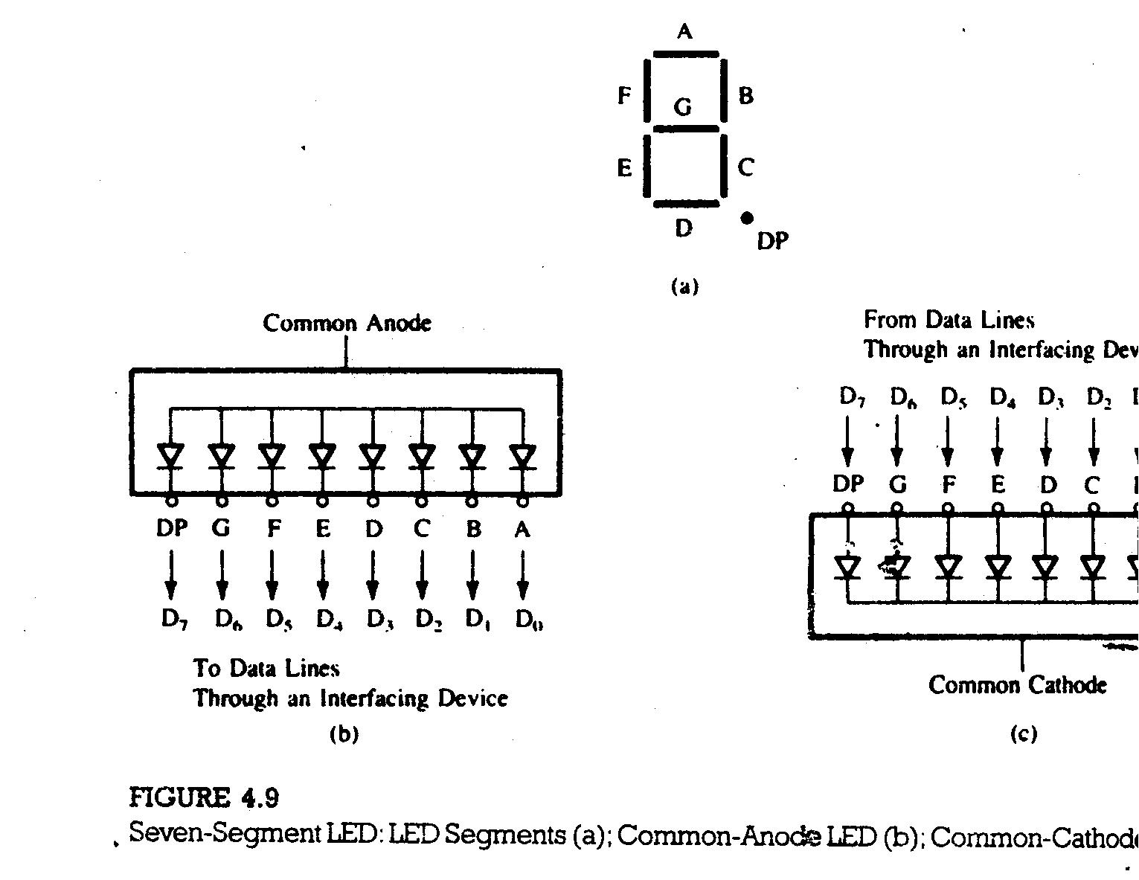

Slide 17
To display digit 7 at the LED in Figure 4.10, the requirements are as follows:
It is a common-anode seven-segment LED, and logic 0 is required to turn on a segment.
To display digit 7, segments A, B, and C should be turned on.
The binary code should be
Data Lines
Bits
Segments
D₇ D₆ D₅ D₄ D₃ D₂ D₁ D₀
X 1 1 1 1 0 0 0
= 78H
NC G F E D C B A

Slide 18
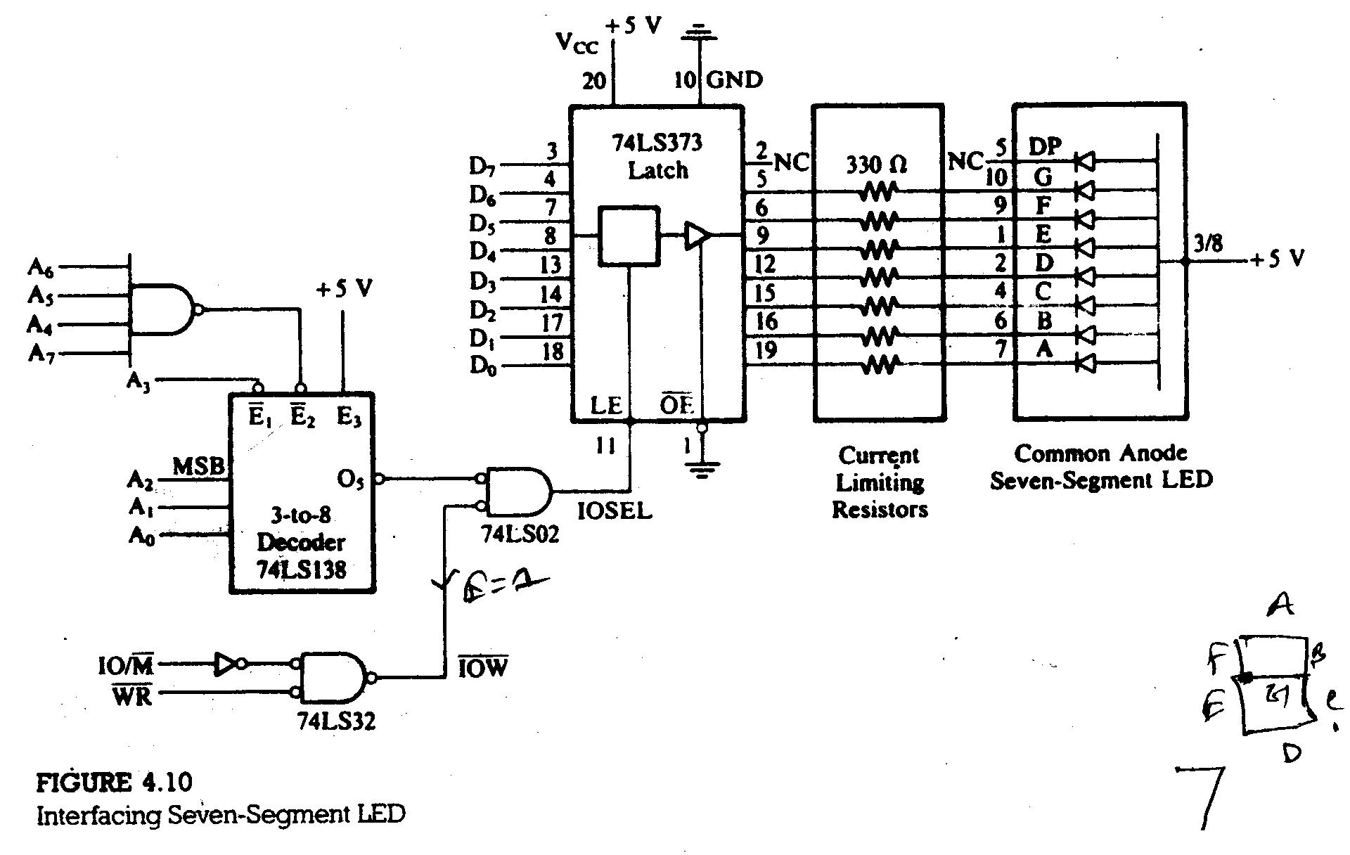

Slide 19
To design an output port with the address F5H, the address lines A₇ – A₀ should have following logic:
Instructions:
The following instructions are necessary to display 7 at the output port:
MVI A, 78H
OUT F5H
HLT
A₇ A₆ A₅ A₄ A₃ A₂ A₁ A₀
1 1 1 1 0 1 0 1
= F5H

Slide 20
4.3 INTERFACING INPUT DEVICES
4.31 Illustration: Data Input from DIP Switches
The circuit used for interfacing eight DIP switches, as shown in Figure 4.11. The circuit shows the 74LS138 3-to-8 decoder to decode the low-order bus and tri-state octal buffer (74LS244) to interfaces the switches to the data bus. The port can be accessed with the address 84H.
4.32 Hardware
Figure 4.11 shows the 74LS244 tri-state octal buffer used as an interfacing device. When OE signal goes low, the input data show up on the output lines (connected to the data bus).

Slide 21
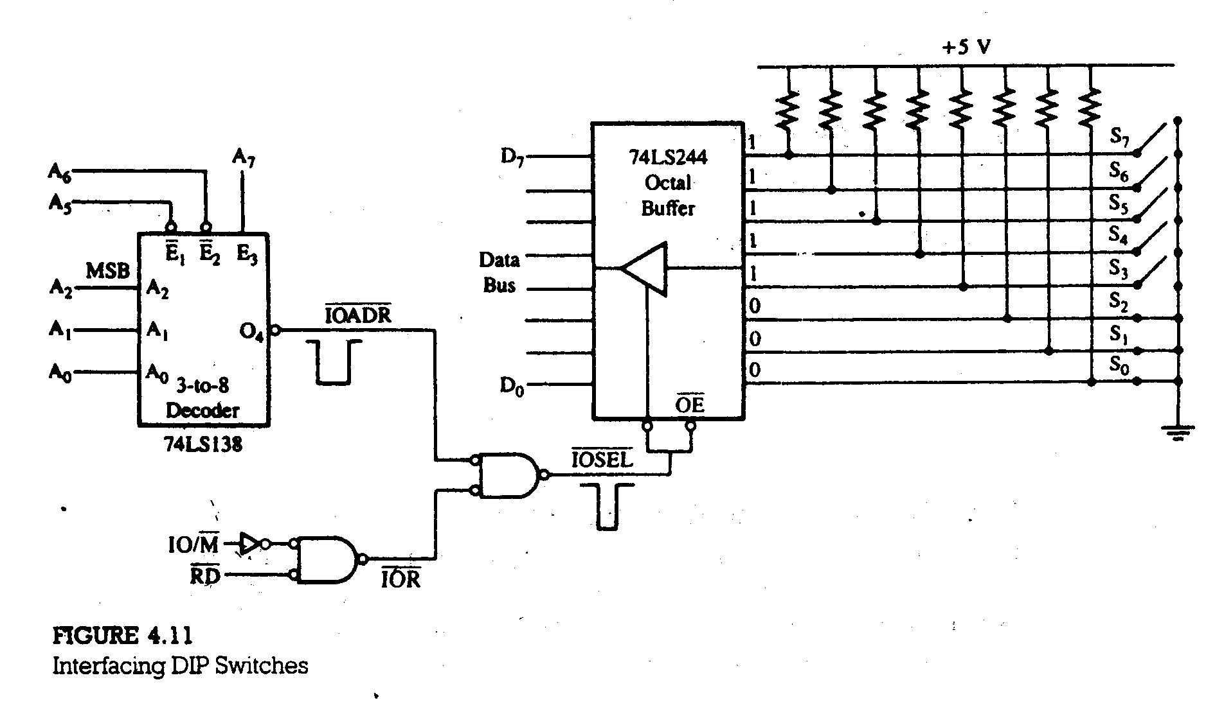

Slide 22
4.33 Interfacing Circuit
Figure 4.11 shows that the address lines A₄ and A₃ are left in the don’t care state. The output line OE goes low when the address bus has the following address (assume the don’t care lines are at logic 0):
4.34 Multiple Port Address
In Figure 4.11, the address lines A₄ and A₃ are not used by the decoding circuit; the logic levels on these lines can 0 or 1. Therefore, this input port can be accessed by four different addresses, as shown below.
A₇ A₆ A₅ A₄ A₃ A₂ A₁ A₀
1 0 0 0 0 1 0 0
= 84H
A₇ A₆ A₅ A₄ A₃ A₂ A₁ A₀
1 0 0 0 0 1 0 0
= 84H
= 8CH
= 94H
= 9CH
0 1
0
1 1

Slide 23
4.35 Instructions to Read Input Port
To read data from the input port shown in Figure 4.11, the instructions are as follows:
IN 84H
HLT
When the instruction IN 84H is executed, during M₃ cycle, the 8085 places the address 84H on the low-order (as well as high-order bus), asserts the RD control signal, and reads the switch positions.

Slide 24
4.4 MEMORY- MAPPED I/O
In memory-mapped I/O, the input and output devices are assigned and identified by 16-bit addresses. To transfer data between the MPU and I/O devices, memory-related instructions (such as LDA, STA etc.) and memory control signals MEMR and MEMW are used.
To understand memory-mapped I/O technique, the following example is considered:
Memory Address Machine Code Mnemonics
2050 32 STA 8000H
2051 00
2052 80
The STA is a three-byte instructions.

Slide 25
In memory-mapped I/O technique both the memory and I/O devices uses the common domain of addressing. That is an input device or an output device can be connected to the memory location.
4.41 Execution of Memory-Related Data Transfer Instructions
To execute the STA instruction, 8085 microprocessor requires four machine cycles (M₁ to M₄) and thirteen T-states (Figure 4.12). The machine cycle M₄ for the STA instruction is similar to the machine cycle M₃ for the OUT instruction.
Device selection and data transfer in memory-mapped I/O require three steps that are similar to those required in peripheral I/O:
Decode the address bus to generate the device address pulse.
AND the control signal with the device address pulse to generate the device select pulse.
Use the device select pulse to enable the I/O port.

Slide 26
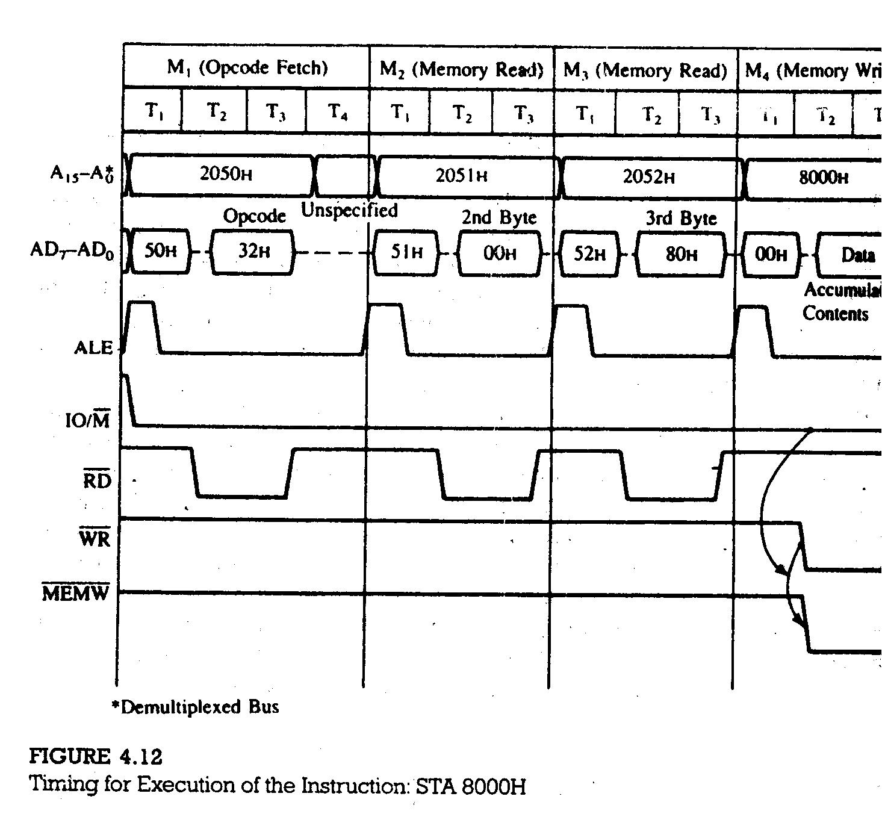

Slide 27
4.42 Illustration: Safety Control System Using Memory-Mapped I/O
Technique
Figure 4.13 shows a schematic of interfacing I/O devices using the memory-mapped I/O technique. The circuit includes one input port with eight DIP switches and one output port to control various processes and gates, which are turned on/off by the microprocessor according to the corresponding switch position.
OUTPUT PORT AND ITS ADDRESS
The various process control devices are connected to the data bus through the latch 74LS373 and solid state relays. When LE is high, the data enter the latch and when LE goes low, data are latched. The latched data are available on the output lines enabled by OE. To assert the I/O select pulse, the output port address should be FFF8H, as shown below:
A₁₅ A₁₄ A₁₃ A₁₂ A₁₁ A₁₀ A₉ A₈ A₇ A₆ A₅ A₄ A₃ A₂ A₁ A₀
1 1 1 1 1 1 1 1 1 1 1 1 1 0 0 0
= FFF8H

Slide 28
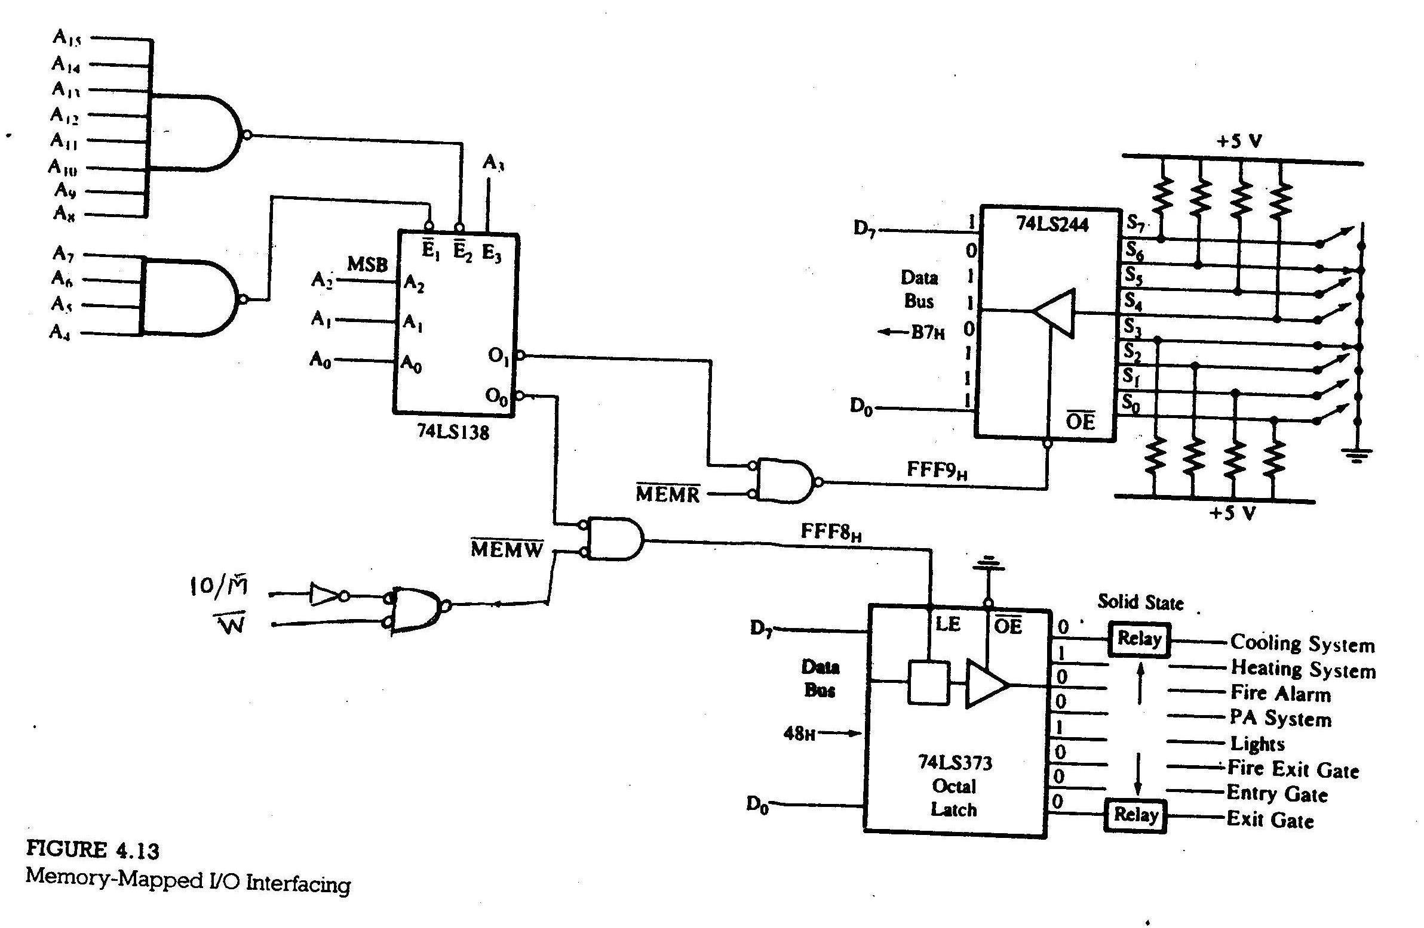

Slide 29
INPUT PORT AND ITS ADDRESS
The DIP switches are interfaced with the 8085 using tri-state buffer 74LS244. The switch positions can be read by enabling the signal OE. To read the input port, the port address should be
Instruction:
To control the processes according to switch positions, the microprocessor should read the bit pattern at the input port and send that bit pattern to the output port. The following instructions can accomplish this task:
READ: LDA FFF9H
CMA
STA FFF8H
JMP READ
A₁₅ A₁₄ A₁₃ A₁₂ A₁₁ A₁₀ A₉ A₈ A₇ A₆ A₅ A₄ A₃ A₂ A₁ A₀
1 1 1 1 1 1 1 1 1 1 1 1 1 0 0 1
= FFF9H

